Slide 1
ATAI
Advanced Techniqueof Artificial Intelligence
ATAI
ChongqingUniversity _{AdvancedTechniqueof}
of Technology Artificial Intelligence
Chongqing University of
Technology
Chongqing University ^{ATAI}
_{of Technology} Advanced Techniqueof
Artificial Intelligence
Chongqing University of Technology
Chongqing University of Technology
LightGNN: Simple Graph Neural Network for Recommendation
Code: https://github.com/HKUDS/LightGNN
2025.2.27•ChongQing
—— WSDM 2025
Reported by Shunan Yin
1

Slide 2
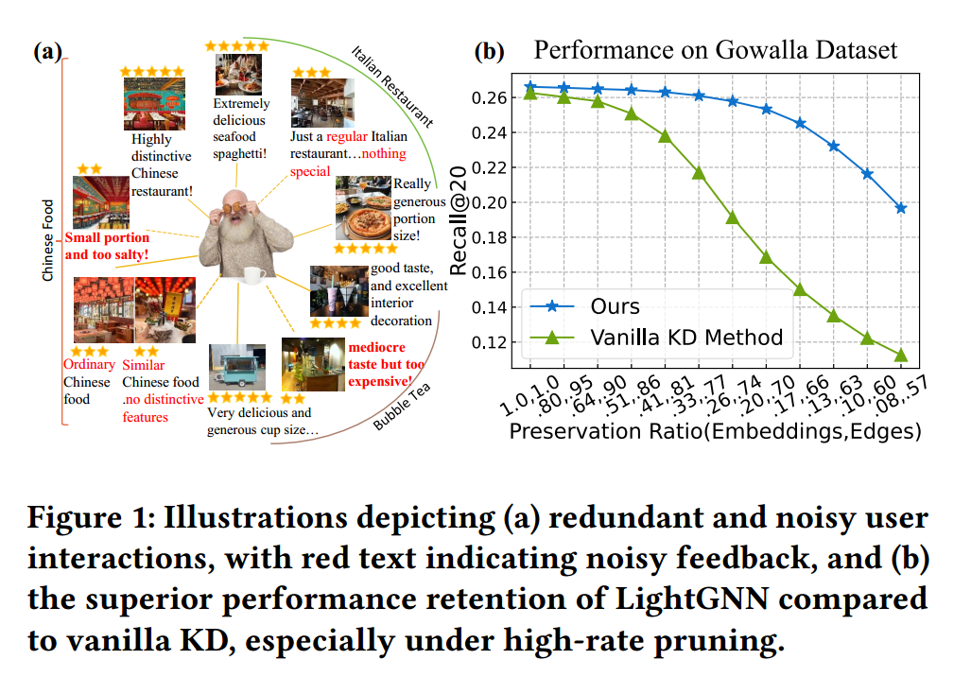
ATAI
AdvancedTechniqueof
Artificial Intelligence
ATAI
ChongqingUniversity _{AdvancedTechniqueof}
of Technology Artificial Intelligence
ChongqingUniversity of Technology
Motivation
i) Limited scalability of GNNs: Online recommendation services handle amounts of relational data. This causes the size of user-item graphs to increase dramatically, resulting in a number of information propagation operations within GNNs.
ii) Presence of noise in interaction graphs: Collaborative recommenders mainly utilize users’ implicit feedback. However, these interaction records often contain substantial noise that diverges from users’ true preferences, including misclicks and popularity biases.

Slide 3
ChongqingUniversity of Technology
ATAI
AdvancedTechniqueof
Artificial Intelligence
ATAI
ChongqingUniversity _{AdvancedTechniqueof}
of Technology Artificial Intelligence
Overview

Slide 4
ChongqingUniversity of Technology
ATAI
AdvancedTechniqueof
Artificial Intelligence
ATAI
ChongqingUniversity _{AdvancedTechniqueof}
of Technology Artificial Intelligence
Method

Slide 5
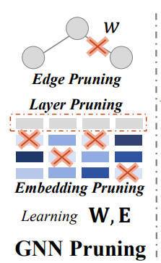
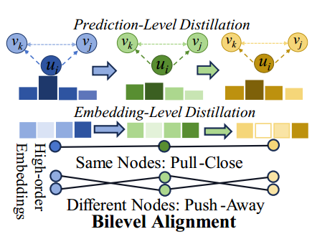
ChongqingUniversity of Technology
ATAI
AdvancedTechniqueof
Artificial Intelligence
ATAI
ChongqingUniversity _{AdvancedTechniqueof}
of Technology Artificial Intelligence
Method

Slide 6
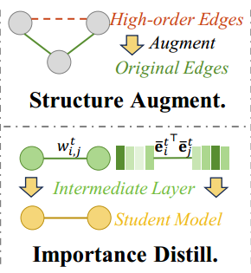
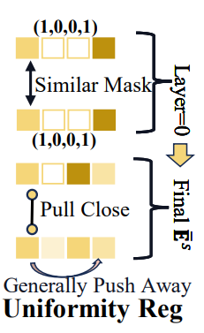
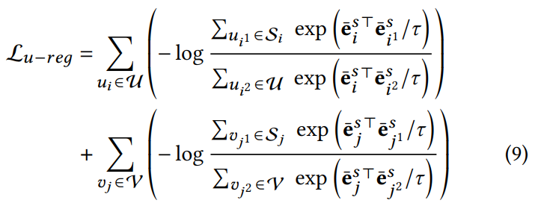
ChongqingUniversity of Technology
ATAI
AdvancedTechniqueof
Artificial Intelligence
ATAI
ChongqingUniversity _{AdvancedTechniqueof}
of Technology Artificial Intelligence
Method

Slide 7
ATAI
AdvancedTechniqueof
Artificial Intelligence
ATAI
ChongqingUniversity _{AdvancedTechniqueof}
of Technology Artificial Intelligence
ChongqingUniversity of Technology
Experiments

Slide 8
ATAI
AdvancedTechniqueof
Artificial Intelligence
ATAI
ChongqingUniversity _{AdvancedTechniqueof}
of Technology Artificial Intelligence
ChongqingUniversity of Technology
Experiments

Slide 9
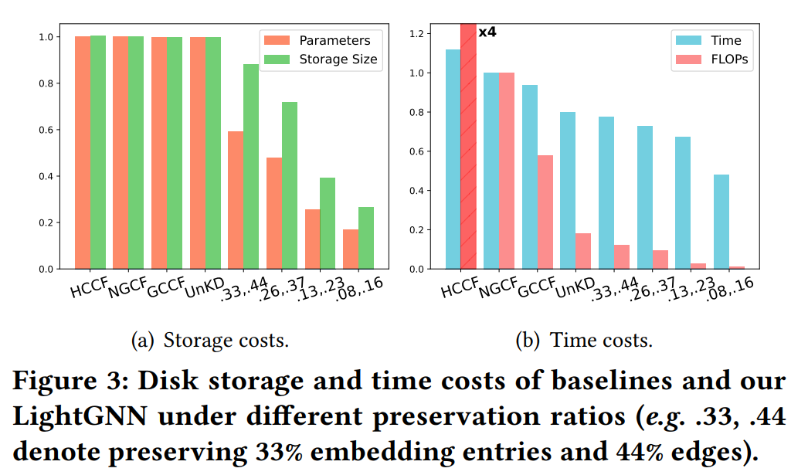
ATAI
AdvancedTechniqueof
Artificial Intelligence
ATAI
ChongqingUniversity _{AdvancedTechniqueof}
of Technology Artificial Intelligence
ChongqingUniversity of Technology
Experiments

Slide 10
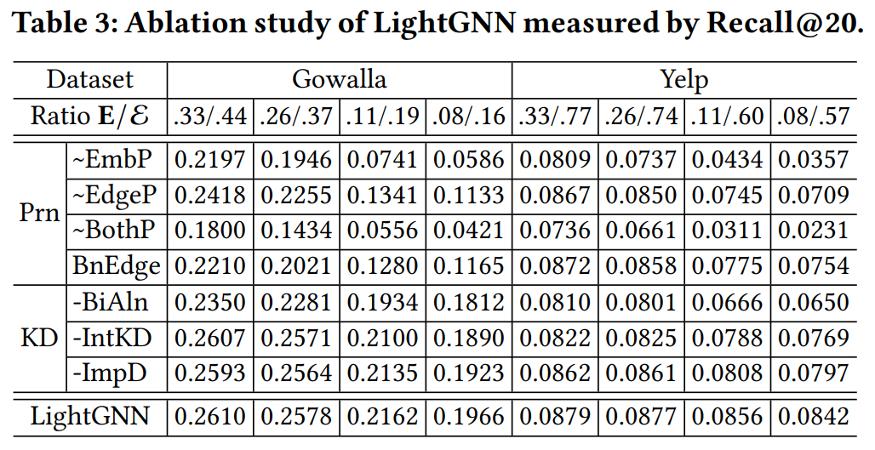
ATAI
AdvancedTechniqueof
Artificial Intelligence
ATAI
ChongqingUniversity _{AdvancedTechniqueof}
of Technology Artificial Intelligence
ChongqingUniversity of Technology
Experiments

Slide 11
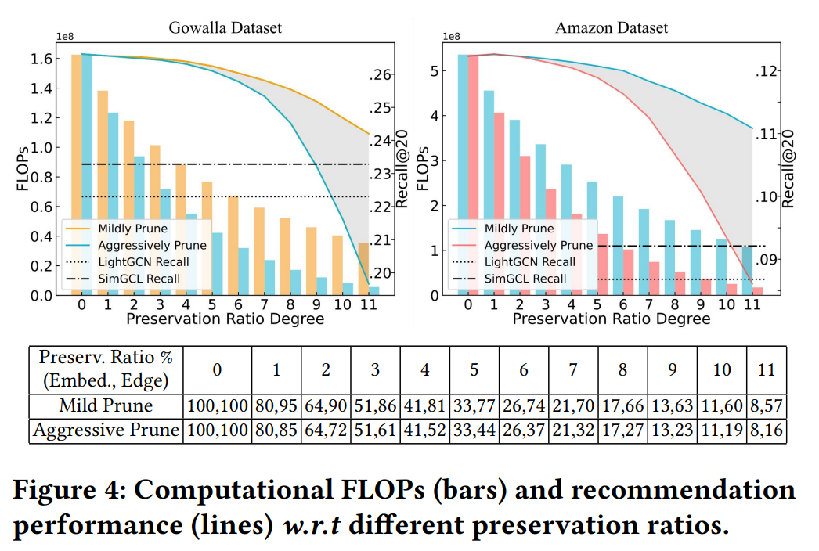
ATAI
AdvancedTechniqueof
Artificial Intelligence
ATAI
ChongqingUniversity _{AdvancedTechniqueof}
of Technology Artificial Intelligence
ChongqingUniversity of Technology
Experiments

Slide 12
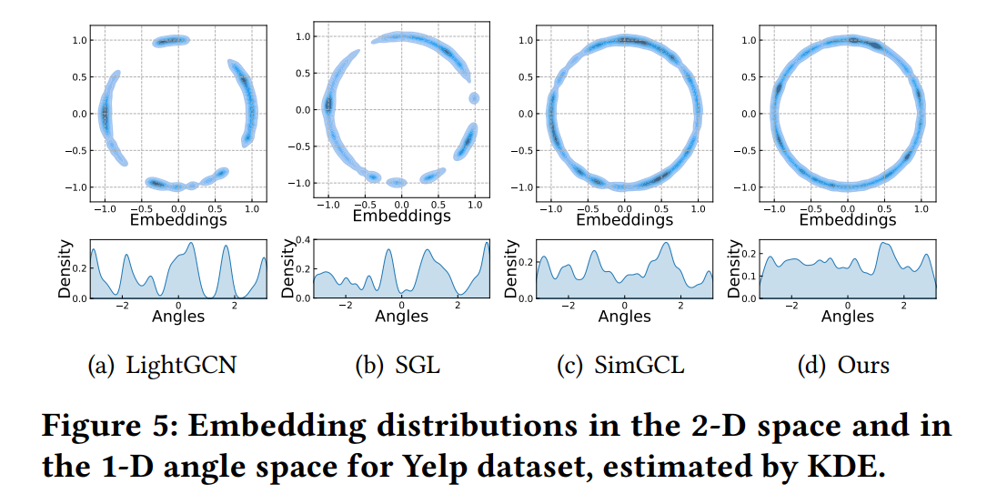
ATAI
AdvancedTechniqueof
Artificial Intelligence
ATAI
ChongqingUniversity _{AdvancedTechniqueof}
of Technology Artificial Intelligence
ChongqingUniversity of Technology
Experiments

Slide 13
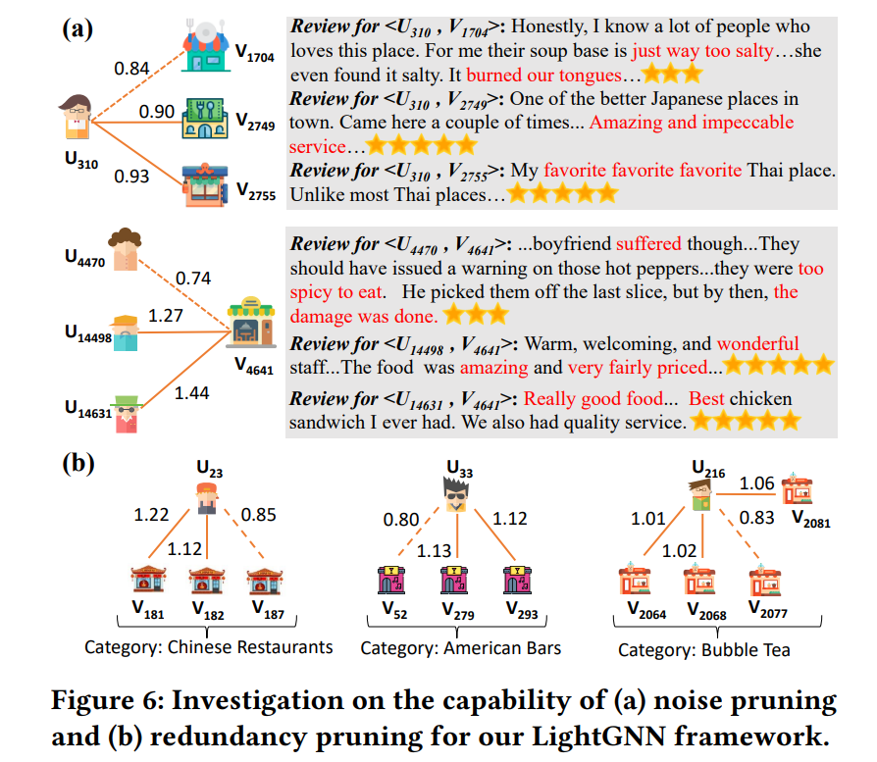
ATAI
AdvancedTechniqueof
Artificial Intelligence
ATAI
ChongqingUniversity _{AdvancedTechniqueof}
of Technology Artificial Intelligence
ChongqingUniversity of Technology
Experiments

Slide 14
ChongqingUniversity of Technology
ATAI
AdvancedTechniqueof
Artificial Intelligence
ATAI
ChongqingUniversity _{AdvancedTechniqueof}
of Technology Artificial Intelligence
Thanks!

